Slide 1
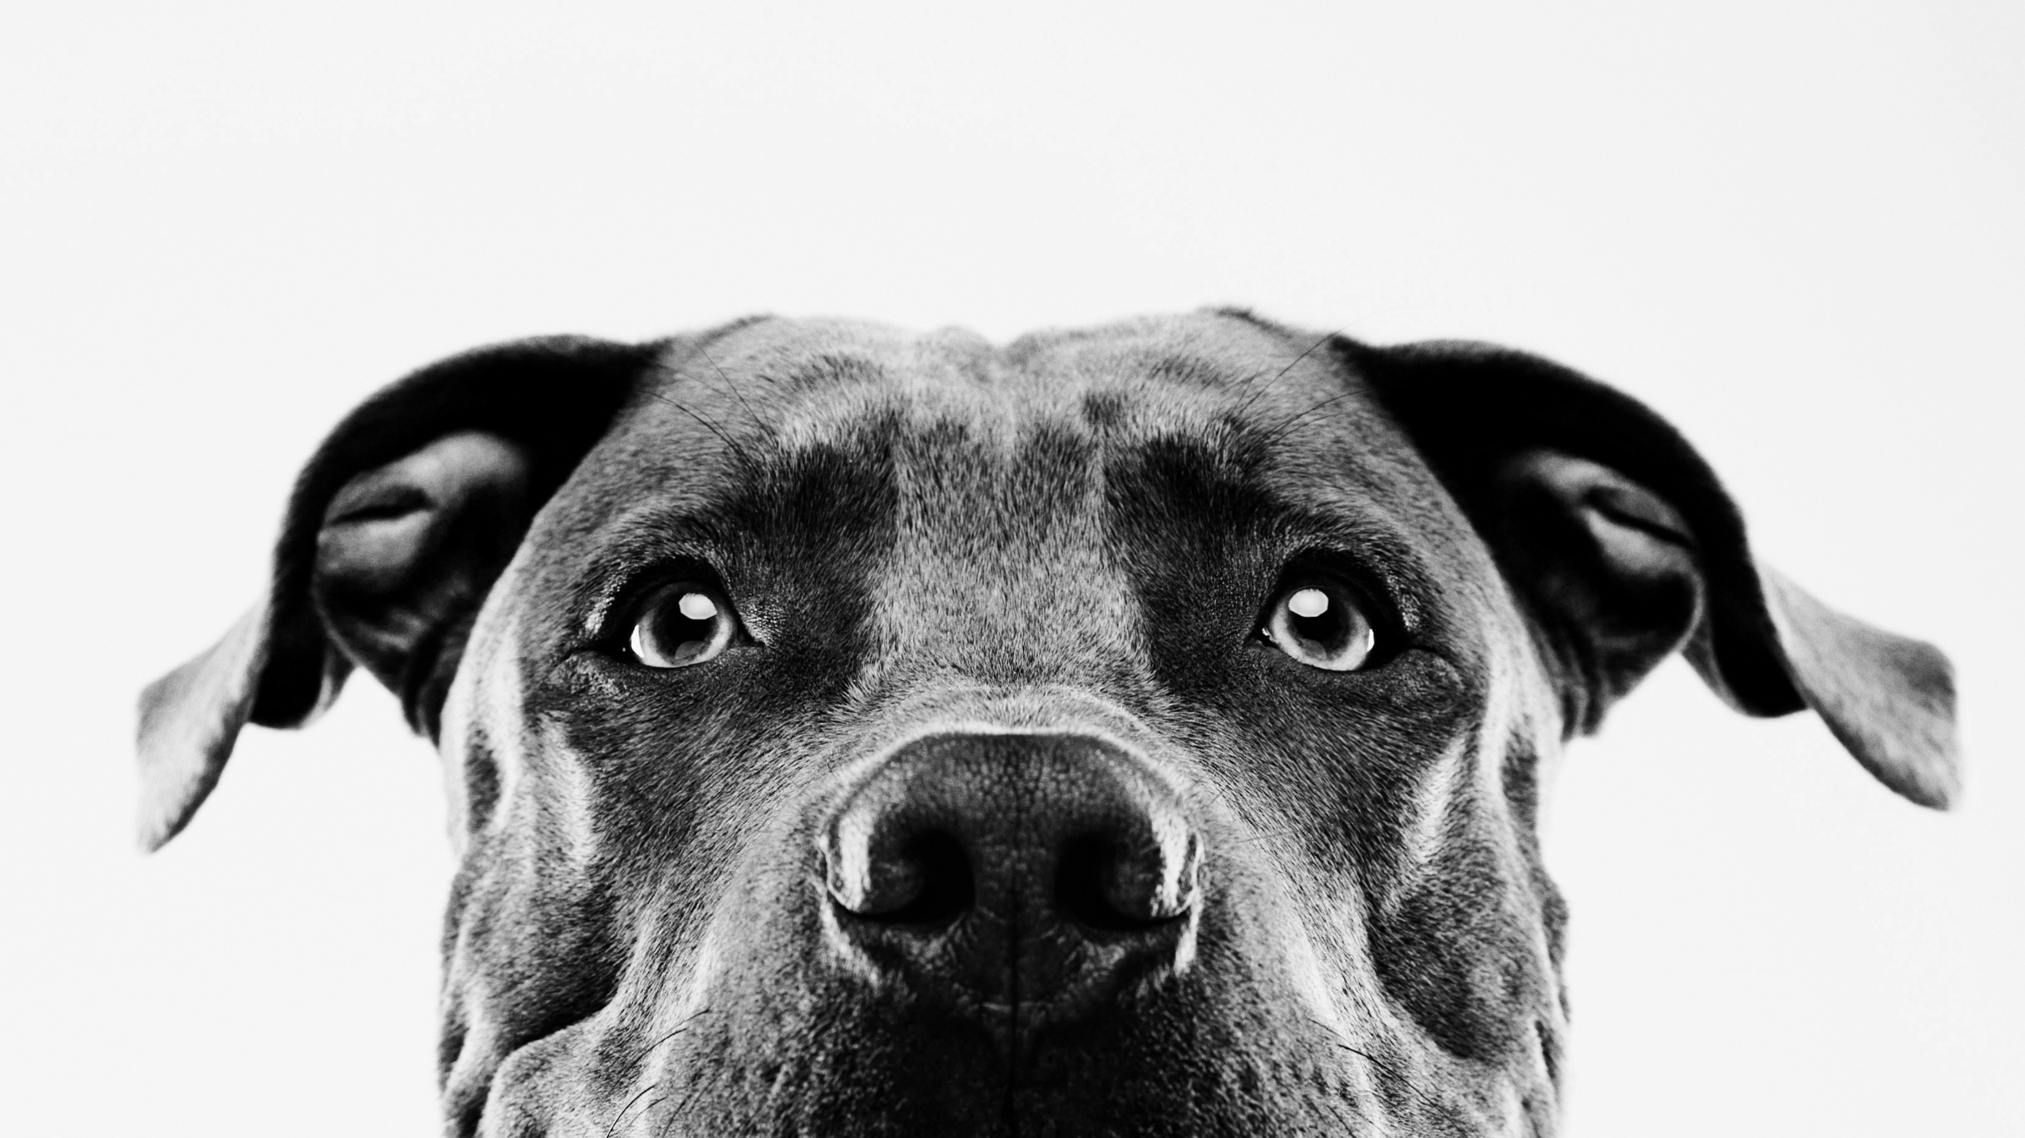
GOOD MORNING

Slide 2

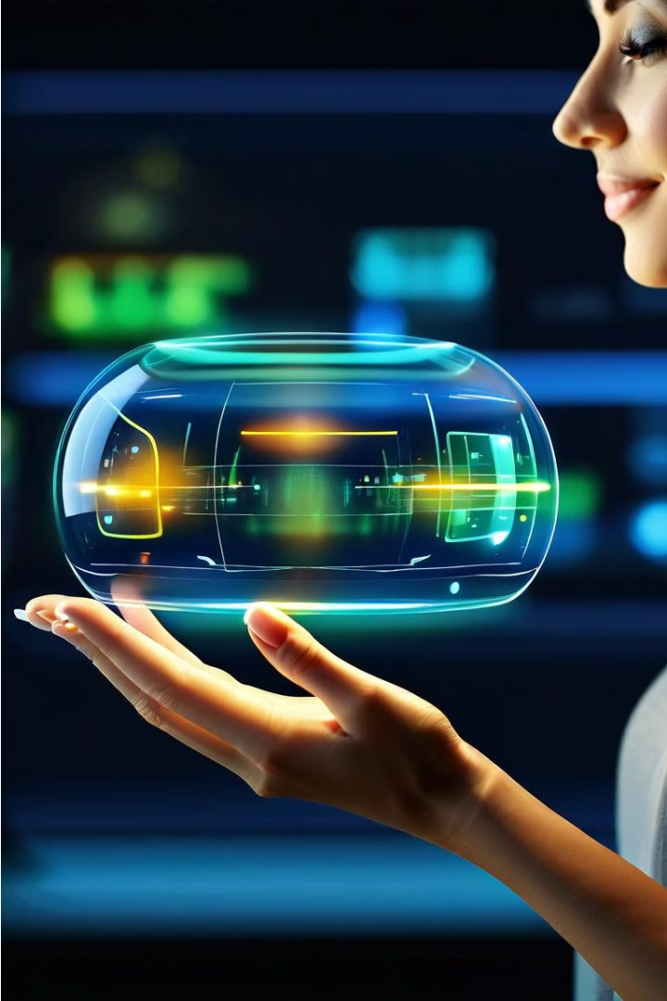
Introduction to Virtual Mouse By Hand Recognition using Python
In today's increasingly digital world, the traditional mouse and keyboard setup is often cumbersome and limiting. The introduction of virtual mouse technology powered by hand recognition and Python programming offers a revolutionary way to interact with computers. This innovative approach allows users to control the cursor and perform various mouse functions using natural hand gestures, providing a more intuitive and immersive computing experience.

Slide 3
Objective of the Virtual Mouse
1
Intuitive Cursor Control
2
Gesture-based Functionality
3
Seamless Integration
The primary objective of the virtual mouse is to provide users with a more natural and intuitive way to control the cursor on a computer screen. By leveraging hand recognition and gestures, users can navigate and interact with digital content without the need for a physical mouse.
The virtual mouse system aims to expand the capabilities of traditional mouse interactions by allowing users to perform various functions, such as left-clicking, right-clicking, and scrolling, through a series of pre-defined hand gestures.
The ultimate goal is to seamlessly integrate the virtual mouse into existing computer systems and workflows, providing a natural and efficient way for users to interact with their digital environments without disrupting their productivity or workflow.

Slide 4
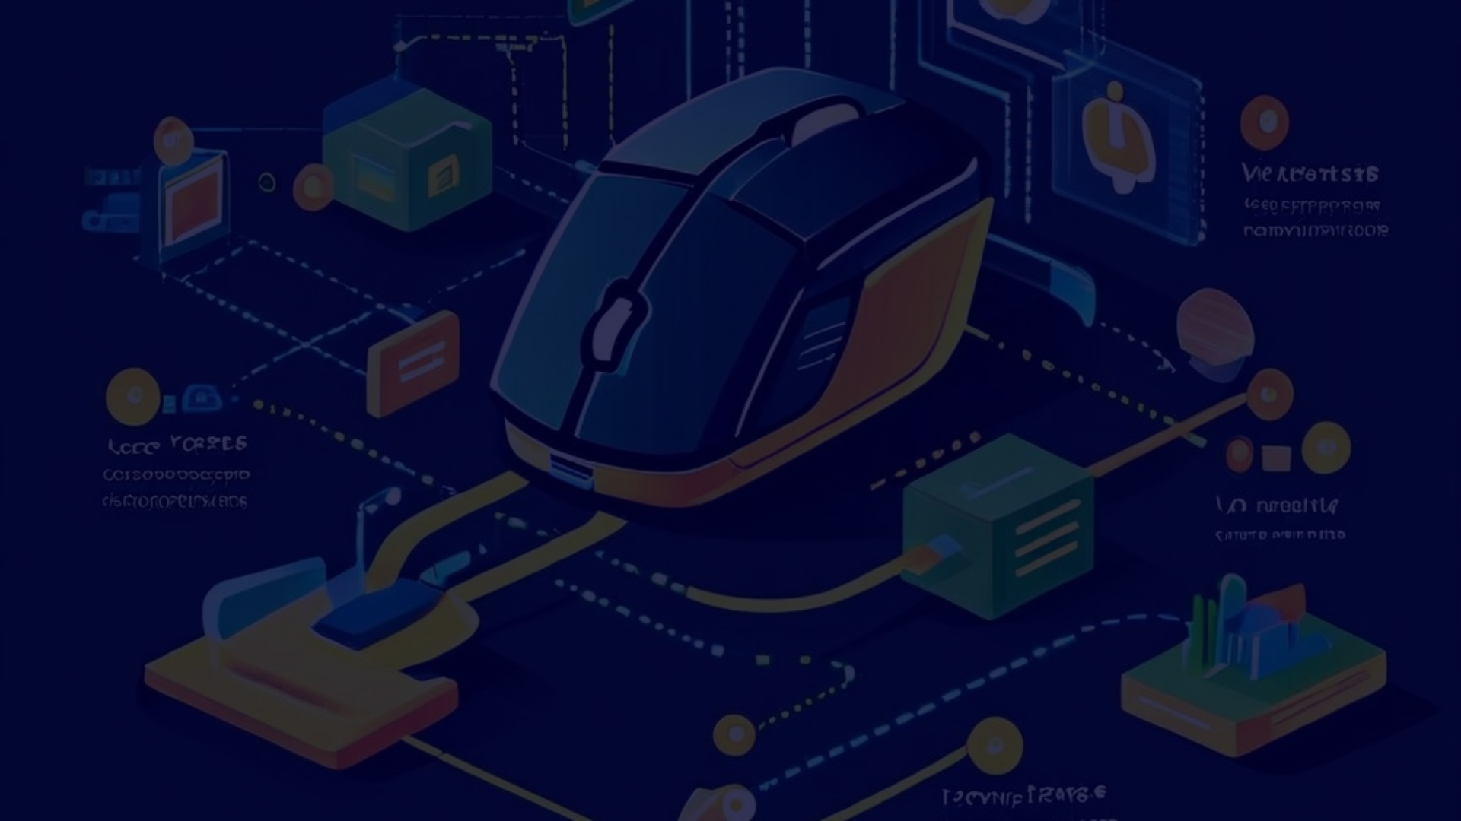
Proposed Methodology
Hand Detection
1
The first step in the proposed methodology is to accurately detect and track the user's hand movements using computer vision techniques and Python-based libraries, such as OpenCV or MediaPipe.
2
Gesture Recognition
Once the hand is detected, the system will analyze the user's hand gestures to identify specific commands or actions, such as clicking, scrolling, or zooming, using machine learning algorithms and pre-defined gesture models.
Cursor Control
3
The recognized hand gestures will then be mapped to corresponding cursor movements and mouse functions, allowing the user to seamlessly control the computer interface using natural hand motions.

Slide 5
Hardware and Software Requirements
Hardware Requirements
Software Requirements
Integrating the Components
The virtual mouse system requires a camera, such as a webcam or depth sensor, to capture the user's hand movements. The computer or device running the system should have sufficient processing power to handle the real-time hand tracking and gesture recognition algorithms.
On the software side, the virtual mouse system relies on Python as the programming language, along with various libraries and frameworks, such as OpenCV for computer vision, NumPy for numerical operations, and TensorFlow or PyTorch for machine learning-based gesture recognition.
The hardware and software components must be seamlessly integrated to create a responsive and accurate virtual mouse system. This may involve developing custom drivers or middleware to bridge the gap between the camera input and the cursor control algorithms.

Slide 6
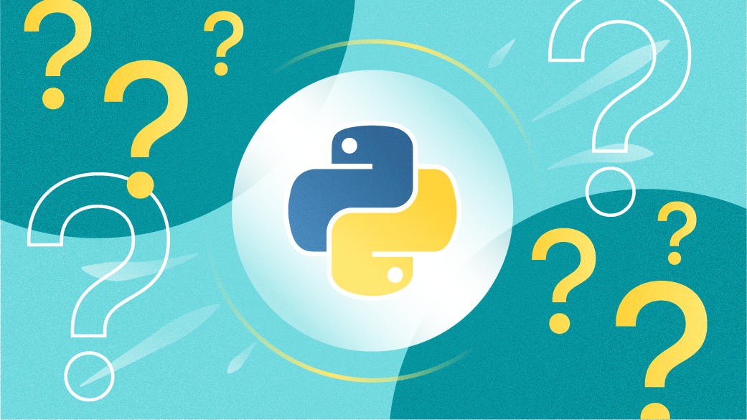




Python Libraries Used
Python
OpenCV
Mediapipe
PyAutoGUI
Python is the primary programming language used in this virtual mouse project. It provides a robust and flexible platform for developing computer vision and human-computer interaction applications.
OpenCV (Open Source Computer Vision Library) is a powerful open-source library for computer vision and machine learning tasks. It offers a wide range of functions for real-time image and video processing, which are crucial for the hand detection and tracking components of the virtual mouse.
MediaPipe is a cross-platform library developed by Google that provides a suite of libraries and tools for applying artificial intelligence (AI) and machine learning (ML) techniques in applications. It is designed to be lightweight, efficient, and easy to use, making it suitable for a wide range of devices, from mobile to IoT.
PyAutoGUI is a cross-platform GUI automation library that allows programmatic control of the mouse and keyboard. It is used in this virtual mouse project to capture and manipulate the cursor movements and mouse click events based on the hand gestures detected.

Slide 7
Hand Detection and Tracking Techniques
Computer Vision Algorithms
Depth Sensing
The virtual mouse system leverages advanced computer vision algorithms, such as convolutional neural networks (CNNs) and keypoint detection, to accurately detect and track the user's hand movements in real-time. These algorithms analyze the camera input to identify the hand's position, orientation, and gestures.
Depth-sensing technologies, like those found in modern cameras and depth sensors, can provide additional information about the user's hand, such as its distance from the camera and the 3D structure of the fingers. This data can further improve the accuracy and robustness of the hand tracking and gesture recognition processes.
Machine Learning Models
Sensor Fusion
The virtual mouse system may also incorporate machine learning models, such as support vector machines (SVMs) or long short-term memory (LSTMs), to recognize and classify the user's hand gestures based on the input data from the computer vision and depth sensing algorithms.
By combining data from multiple sensors, such as cameras, depth sensors, and inertial measurement units (IMUs), the virtual mouse system can achieve more accurate and robust hand tracking and gesture recognition, even in complex or challenging environments.

Slide 8




Cursor Control and Mouse Functionality
Cursor Movement
Left-click and Right-click
Scrolling and Zooming
The virtual mouse system translates the user's hand movements into corresponding cursor movements on the computer screen, allowing for precise and intuitive control of the cursor.
The virtual mouse system can also interpret hand gestures, such as swiping or two-finger movements, to enable scrolling, panning, and zooming functionality within various applications and interfaces.
By recognizing specific hand gestures, such as a pinching motion or a spread-out palm, the virtual mouse system can emulate the functionality of left-clicking and right-clicking with a traditional mouse.

Slide 9
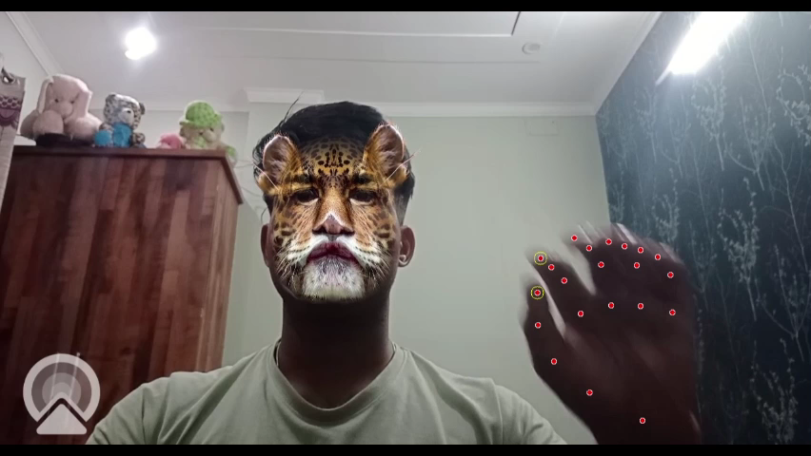
OUTPUT

Slide 10





Advantages and Applications of Virtual Mouse
Accessibility
Mobility and Flexibility
Improved Efficiency
Immersive Experiences
The virtual mouse system provides an accessible and inclusive way for users, including those with physical disabilities, to interact with computers and digital environments without the need for a traditional mouse.
The virtual mouse can be used in a variety of settings, from desktops to mobile devices, allowing users to control their digital environments seamlessly, regardless of their location or device.
By leveraging natural hand gestures, the virtual mouse can enhance productivity and workflow, as users can perform common computer tasks more intuitively and with greater speed.
The virtual mouse technology can be particularly beneficial in immersive applications, such as virtual reality (VR) or augmented reality (AR), where traditional input methods may be cumbersome or impractical.

Slide 11
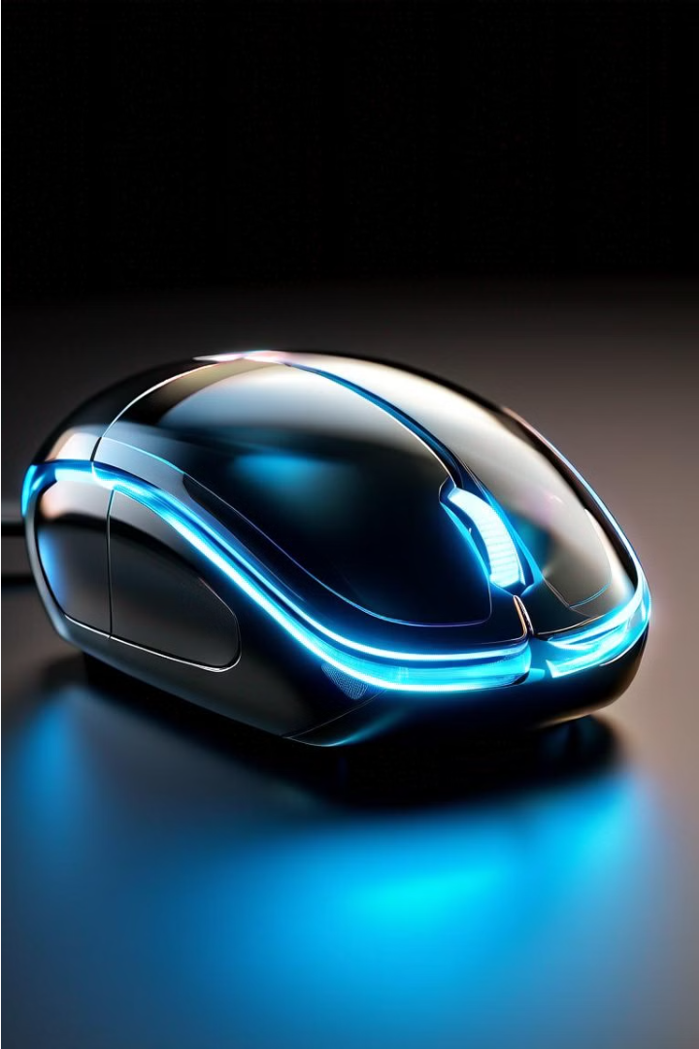
Conclusion and Future Enhancements
Conclusion
1
The virtual mouse technology powered by hand recognition and Python programming represents a significant step forward in human-computer interaction. By providing a more intuitive and natural way to control the cursor and perform various mouse functions, this innovative system has the potential to transform the way we interact with digital environments, enhancing productivity, accessibility, and overall user experience.
2
Future Enhancements
As the virtual mouse technology continues to evolve, researchers and developers are exploring various enhancements, such as improved accuracy and responsiveness through advanced computer vision and machine learning techniques, integration with emerging technologies like augmented reality, and the expansion of gesture-based functionalities to provide users with an even more seamless and immersive computing experience.
Towards a Seamless Future
3
The virtual mouse represents a significant step towards a future where human-computer interaction is more intuitive, natural, and seamless. As this technology continues to advance, it holds the promise of transforming the way we engage with digital spaces, empowering users to navigate and interact with their digital environments in a more intuitive and efficient manner.

Slide 12
Thank you

